Slide 1
Music Genre Classification
ELHAM EMAMI

Slide 2
Data Overview
Dataset from GTZAN
The dataset contains 30-second audio files including 10 different genres:
Reggae
Classical
Country
Jazz
Metal
Pop
Disco, Hiphop, Rock , Blues

Slide 3
Data Wrangling
Songs features have been extracted by Librosa library of Python:
Zero Crossing Rate
Spectral Centroid
Spectral Rolloff
Mel-Frequency Cepstral Coefficients
Chroma Frequencies

Slide 4
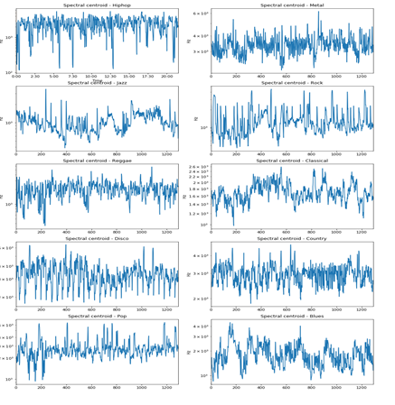
Spectral centroid for each genre
spectral centroid lies in the middle of the blues song while that for the metal song would be toward end of it

Slide 5
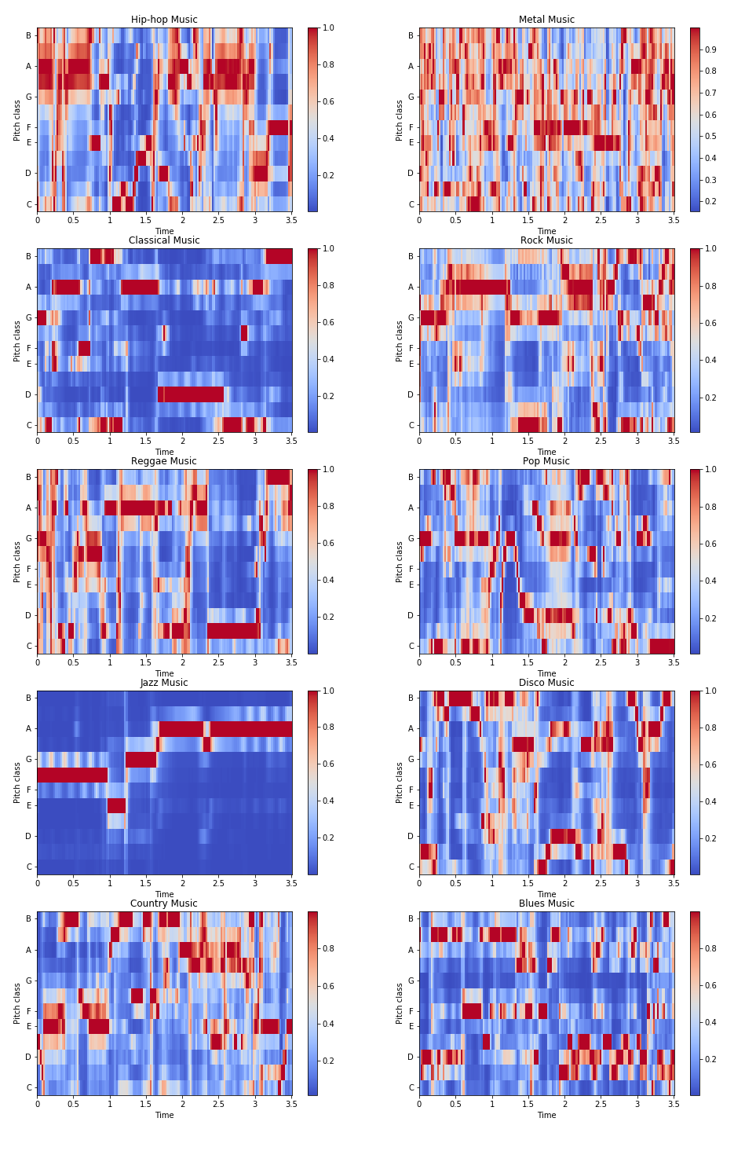
Chroma stft for each genre
There is similarity between the classical and jazz music in term of chroma feature and they follow the linear pattern

Slide 6
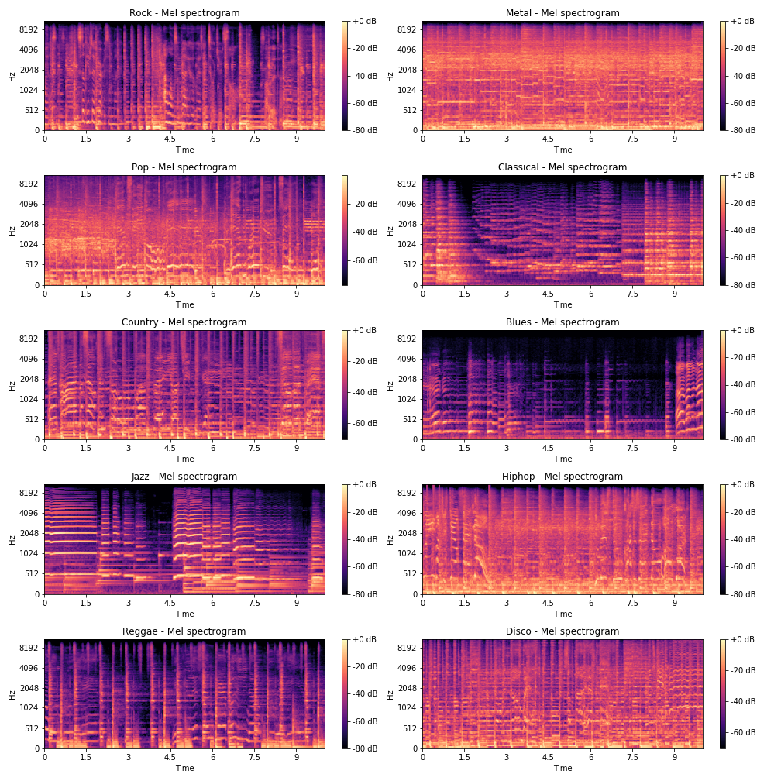
Mel-Frequency Cepstral Coefficients for each genre
This regular spectogram is squashed using mel scale to convert the audio frequencies into something a human is more able to understand.

Slide 7
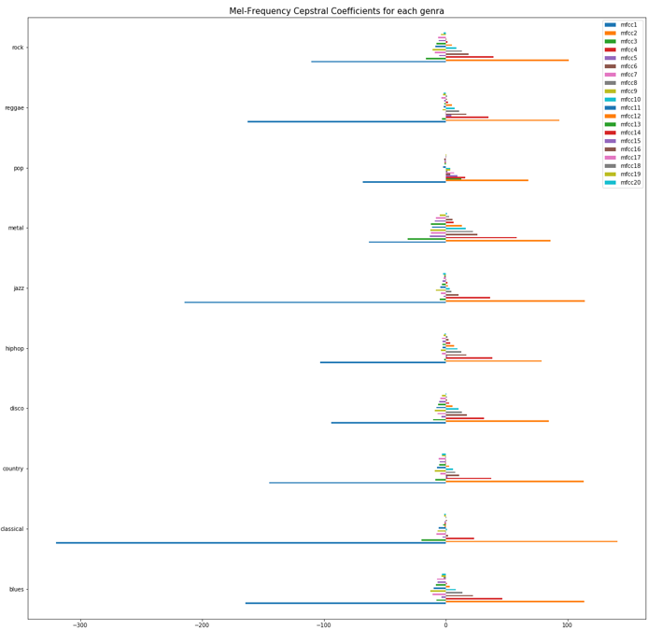
Mel-Frequency Cepstral Coefficients for each genre
Classical music has the very extensive difference between the mel frequency features and pop music can be known as dose have least difference of mel-spectogram feature.

Slide 8

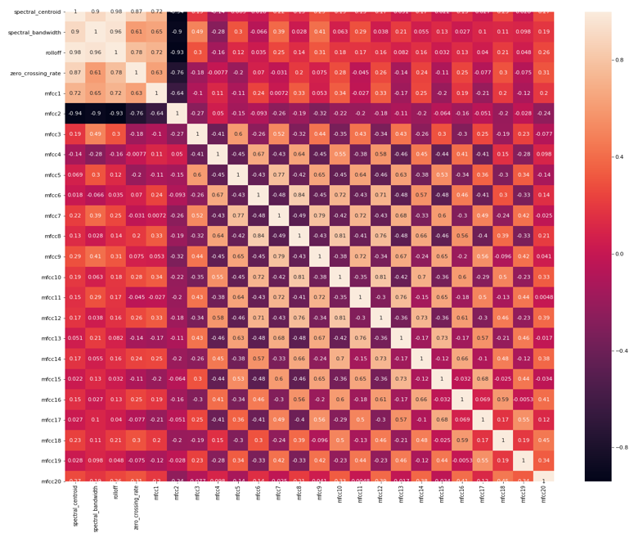
Correlation matrix

Slide 9
Classification
A Convolutional Neural Network (CNN) is comprised of one or more convolutional layers (often with a subsampling step) and then followed by one or more fully connected layers as in a standard multilayer neural network.
use the extracted features
use spectrogram images directly for classification
We’ll use different types of layers for our CNN: Convolutional, Max Pooling, Dropout to prevent the overfitting and Softmax, categorical_crossentropy as loss function and adam optimizer.

Slide 10
CNN
The image dataset has been split into 75% of training data and 25% of test data.
Not a very good accuracy which is 10% and is more a random guess.
Extracted features have been trained as well, this time we have set the epoch size 30 times and our model accuracy is 91%.

Slide 11
Conclusion and Future Work
Deep learning can itself extract useful features from raw mel-spectrograms.
To improve the accuracy, we can use more data, or we can extend the window of examining from 5seconds to 30 seconds

